Slide 1
Humans and Metals – a Relationship History Part 2
Industrial Revolution and metals

Slide 2
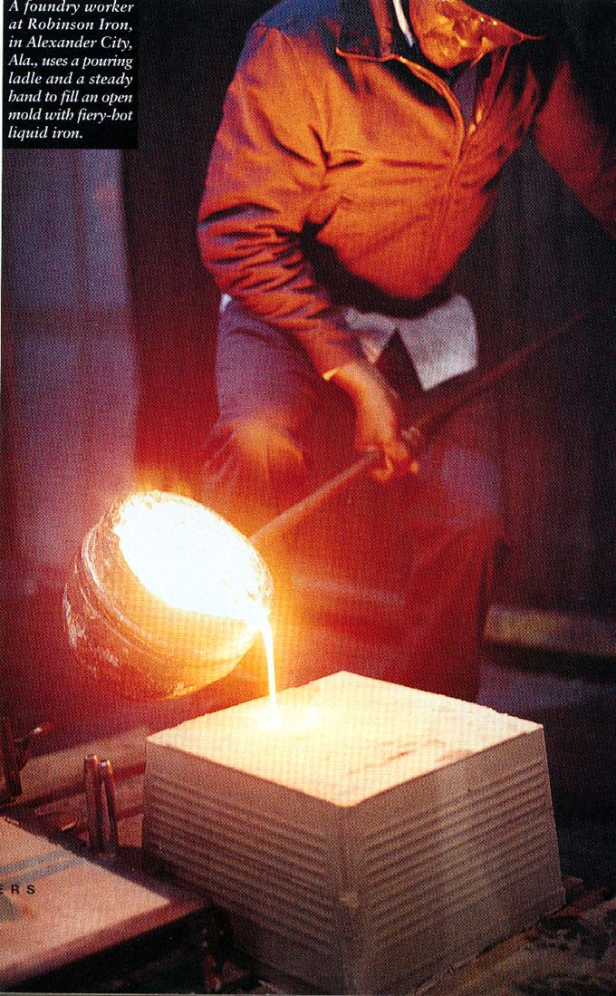
Cast iron was not sufficient to meet the needs of technology
Coke Smelters and Carbon Steel
Cast iron was brittle and hard to work.
Coke made by heating coal in absence of air – drives off volatiles – higher carbon content and thus burns hotter than coal
Around 1740, carbon steel was created
blow air through molten iron
lowers the carbon content to less than 1%
The result was a harder and more workable product.
Notes:
Coke is a fuel with a high carbon content and few impurities, made by heating coal in the absence of air.

Slide 3

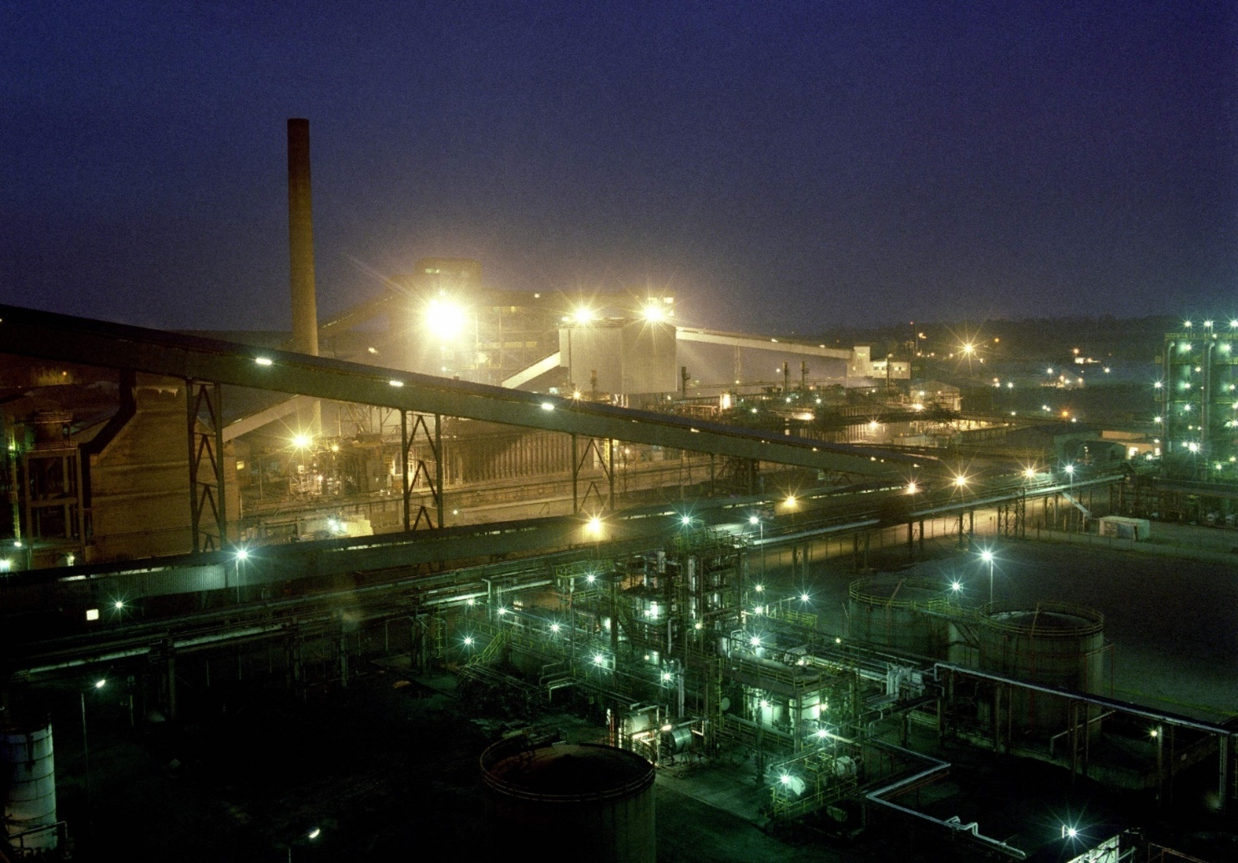
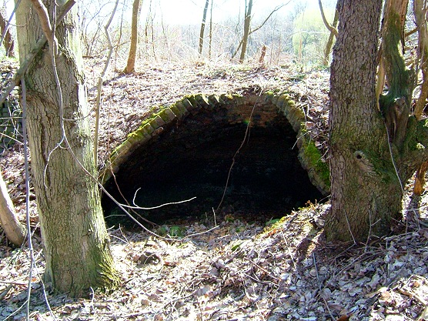
Early Coke Ovens
Modern Coke Ovens

Slide 4

Carbon Steel Revolution
Carbon steel is not only stronger and easier to work, its more flexible.
This flexibility was critical, it allowed us to use steel in construction, like bridges, where flexing is very important
Darby Bridge
Built ~1750

Slide 5
The transition to the Industrial Age
The Iron Age led to the Industrial Revolution (IR) which was fueled by population growth
Urban and industrial society
Others make your goods (in factories)
Rural, agrarian society
You make your own goods

Slide 6
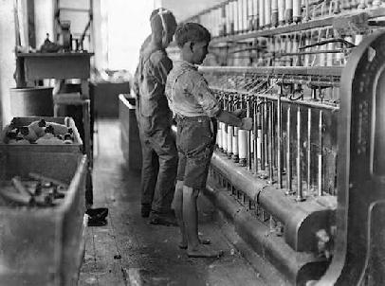
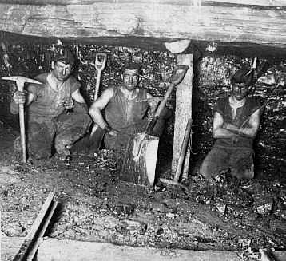
Impact of IR on Working conditions
Child labor
Dangerous
Working
Conditions

Slide 7
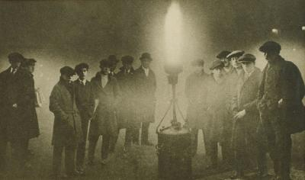
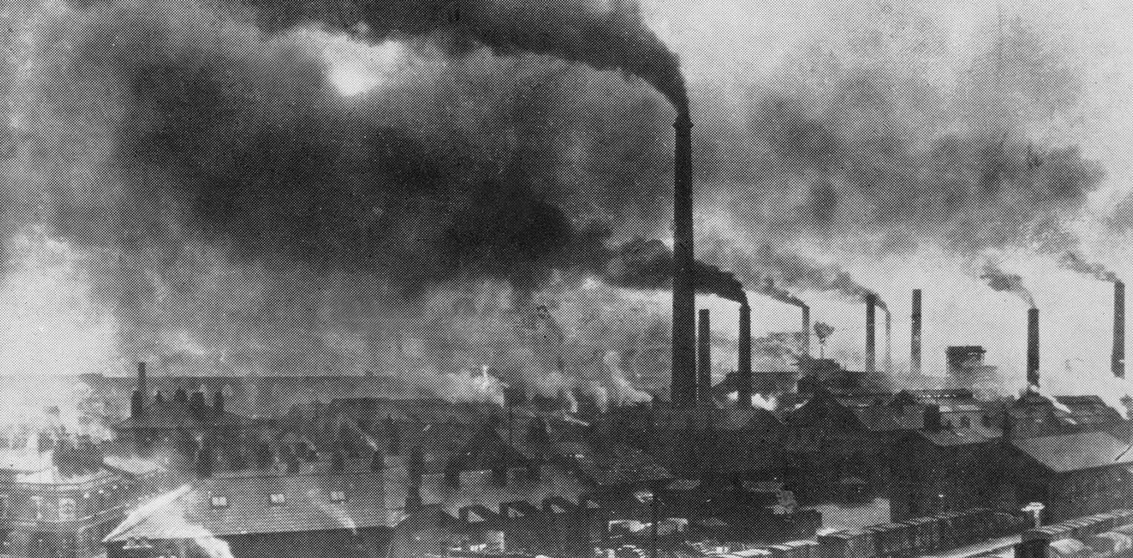
And Pollution…

Slide 8
Implications of IR on Society
The overall effects were:
(1) people migrated to cities
(2) environmental degradation accelerated.
In addition, the need for more energy (coal) created a need for better transportation systems – railroads and canals were built.

Slide 9
IR and other metals
The Industrial Revolution led to many other metals being discovered and utilized
→Alloy – combination of metals or a metal + another element
E.g. Ni-Steel (developed in 1889)

Slide 10
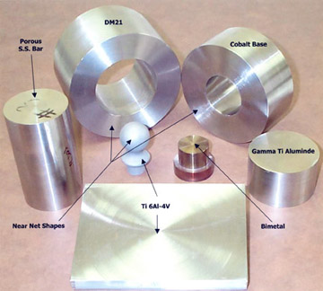
Important Steel Alloys developed at this time
Stainless steel
Ni-steel
Nickel-copper
(carbon steel + chromium + other metals)
Military applications (rocket shells, tank armor, etc.)
Coins (a U.S. nickel is 25% nickel and 75% copper)
- Aluminum was discovered in 1827, but was hard to extract at this time
- Other common steel-alloy metals: include cobalt, titanium, and molybdenum
Notes:
Strength and corrosion resistance

Slide 11
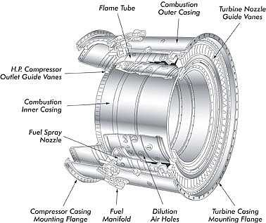
This changed Technology
These advances were spurred by development of the internal combustion engine, aircraft, and weaponry.
Aircraft manufacturing spurred the use of aluminum and titanium.
Jet engines need high strength, yet light, components that can stand high temperatures.

Slide 12
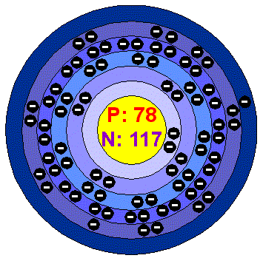

Paved the way for the Modern Age
Energy and Weapons use of uranium and thorium
Medicine
Barium dyes for x-ray diagnostics
Radioactive elements for cancer treatments
Electronics
Gallium and germanium in transducers
Rare Earth elements in color TV phosphores
Catalysts in chemical (oil) processes
Car catalysts – platinum, rhodium, or palladium
Notes:
spent uranium armor piercing projectiles – left over U-238 from nuclear reactors – heavier and denser than lead, burns on impact

Slide 13
Energy use and Technological Advances
Stone Age > Copper Age > Bronze Age > Iron Age > Modern Age
To go from one age to the next required greater energy resources, and increasingly complicated ones.
Wood > charcoal > coal > oil
With these changes comes increasingly complicated and widespread environmental impacts

Slide 14
Important take-aways…
Our modern era began with the industrial revolution, which triggered the need for more coal, iron, and other metals to supply factories and develop cities
This demand created the need for more efficient mining methods and transportation systems
The growth of industry, fed by a growing population, is an upward spiraling process that feeds on itself.

Slide 15
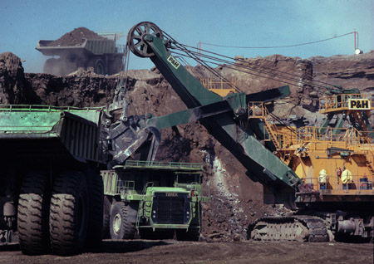
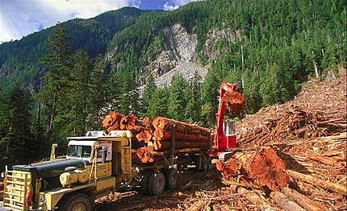
Current relationship status: Wealth and Resources
The majority of Human wealth basically comes from agriculture, manufacturing, or mineral resources.
Our complex modern society is built around the exploitation and use of mineral and natural resources.
Notes:
Simply put,

Slide 16
Economic Growth vs Economic Development
Today’s concept of economic growth – in order to grow we must keep consuming
To accomplish this requires either
Pop. growth to create more producers and consumers
More production and consumption per capita
Or both
Notes:
1770-1900 – when pop doubled, mineral production grew 10-fold
1900-1970 – pop increased by 2.3x, mineral production grew 12-fold (so similar rate)
The between 1970 and 2000, pop doubled again and mineral production tripled!
Population increasing, but also, resource use per capita is dramatically increasing.

Slide 17
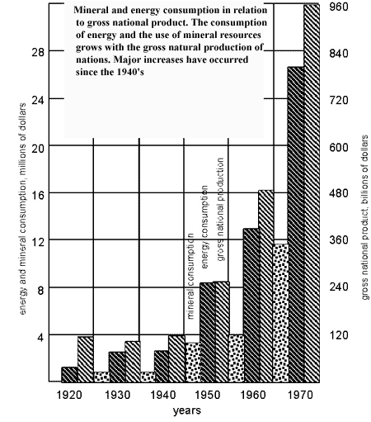

Slide 18
US Consumption of Materials
In 1900 → almost half of the materials consumed were from renewable resources.
By 1995 → consumption of renewable resources had declined dramatically, to only 8 percent of total consumption.
It is believed that the amount of minerals consumed by the U.S.A, since the end of the second world war alone, is more than the total volume of minerals consumed since man started using minerals.

Slide 19
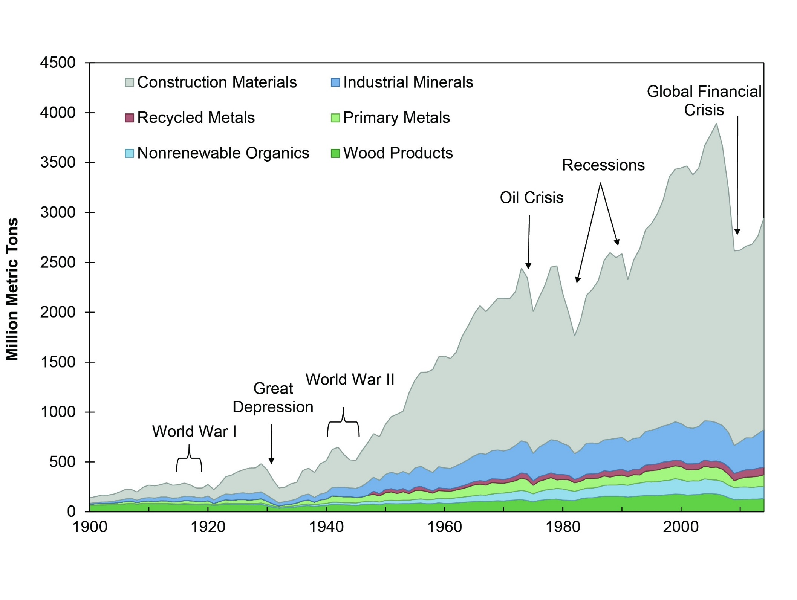
US Consumption of Materials
Source: Matos, G., (2017) Use of raw materials in the United States from 1900 through 2014: U.S. Geological Survey (USGS) Fact Sheet 2017–3062, 6 p.
Notes:
Source: Matos, G., (2017) Use of raw materials in the United States from 1900 through 2014: U.S. Geological Survey (USGS) Fact Sheet 2017–3062, 6 p.

Slide 20
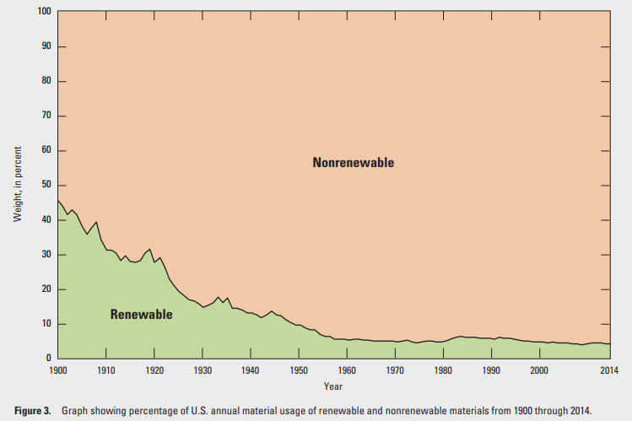
US Consumption of Materials
Notes:
Source: Matos, G., (2017) Use of raw materials in the United States from 1900 through 2014: U.S. Geological Survey (USGS) Fact Sheet 2017–3062, 6 p.

Slide 21
Why the Shift to nonrenewable?
Combination of new products and markets and material replacements in established markets.
Synthetic fibers have replaced natural fibers
Plastics have replaced wood.
Synthetic oils have replaced natural oils.
Replacements because of more desirable properties or cost advantages.

Slide 22


Take hemp
Japan cut off our supply of hemp during WWII

Slide 23
The US and mineral resources today
The US was self sufficient in mineral production in 1875, but now relies heavily on other countries (look at pg. 56 in your textbook!)
With 5% of the worlds population, we use 30% of the world’s mineral resources
Notes:
In 1870 the total mineral consumption of the U.S. was estimated to be worth $456 million.
In 1975, annual consumption was estimated to be worth $27 billion
With current rate of population growth, To bring per capita use of developing countries up to our level of use, would require 700% annual increase in production of each commodity…. With that percent increasing every year, as population grows
By 2050, it could be as much as 1400% per year!

Slide 24
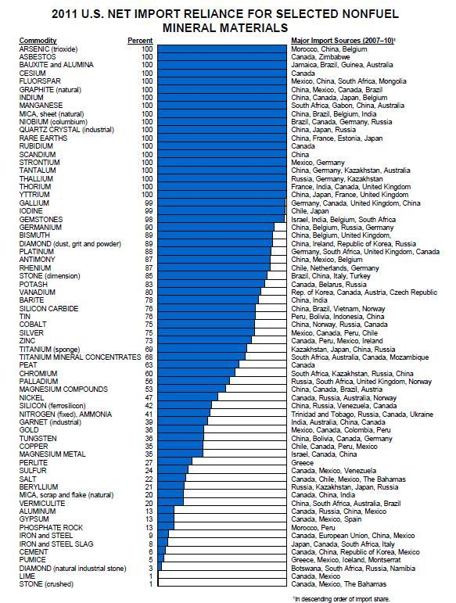
This info is on pg. 56 of textbook
Notes:
Though US is biggest importer, nearly all industrialized nations have similar import dependencies

Slide 25
Important trends in the US
Rate of mineral resource use has risen more rapidly than has the rate of population growth
The percentage of mineral resources being supplied domestically has decreased (percentage imported has increased)
Notes:
What do you think are the cause of these trends?
1 – rise in standard of living, expansion of industry, and to a lesser degree, size of population

